Slide 1
Pairview practical Work Experience Project Data science
24 November, 2020 Submitted by
Gbenga Adebiyi

Slide 2
Adventure Hardware group
Reporting Dashboard . Recommendation Engine . Predictive Model

Slide 3
Executive Summary
The 3 tools built in this project will empower the management of AHG to make data driven decisions, and in-turn increase the commercial value of the business
The Reporting Dashboard will enable a single window summary of the business activity, which will significantly reduce the decision making time
By suggesting products a customer is likely to buy, the Recommendation Engine will increase customer basket sizes and the revenue generated through online sales
The Predictive Model is estimated to cut loss due to customer churn by up to $643,140 every year

Slide 4
1
Reporting Dashboard
Dashboard features – Filters & KPI’s
2
Recommendation Engine
Need for a recommendation engine
Data transformation, model training, evaluation and selection
3
Predictive Model
Purpose of a predictive model
Data exploration
Model training, evaluation and selection
Commercial impact of churn
Purpose of the dashboard
Dashboard screenshot
Model Output
Recommendations to prevent churn

Slide 5
1. Reporting dashboard

Slide 6
Purpose of the dashboard
As a global manufacturer and seller of bikes and bike accessories AHG continuously generates enormous data everyday - across 6 countries and 4 product categories
The management at AHG need – visual, intelligent and real-time insights of the business performance
A dashboard with a clean and intuitive interface, highlighting key performance indicators – will define and support AHGs business decisions

Slide 7




Dashboard filters
Regions
Date
Product category
Drill down to a specific time period, product and region using filters
Sub-product category

Slide 8
Key Performance Indicators
Overall Performance
Total Revenue
Count
Sum units sold
Per Sale
Revenue per sale
Revenue per customer
Per Customer
Cost per customer
Profit per customer
Total unique customers
Count of items purchased in every transaction
Total Cost
Total Profit
Cost per sale

Slide 9
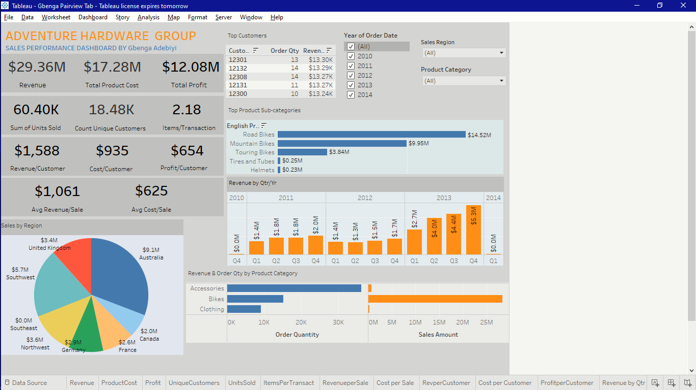
Top 5 Customers
Top 5 Customers
Region Filter
Key Performance Indicators
Product category Filter
Top 5 Product Sub-categories
Net Revenue over Selected Time Period Chart
Net Revenue by Region Chart
Net Revenue & Quantity by Product Category Chart

Slide 11
2. Recommendation engine

Slide 12

Need for a Recommendation Engine
AHG has been selling bikes online over the last 4 years. Last year they introduced clothes and accessories as new categories online
Online sales are account for 1/3rd of the Net Revenue and 11.8 million net profit
The key focus now is to increase each customer basket value and in turn, increase the revenue and profits from the online channel
The tool will be able to search for a recommendation list based on a specified user, such that:
Input: customer ID
Returns: ranked list of items (product IDs), that the user is most likely to want to put in his/her (empty) “basket”

Slide 13
Methodology
Transforming and normalizing data
Training models
Evaluating model performance
Selecting the optimal model

Slide 14
Transforming and Normalizing Data
Transforming and normalizing data
Training models
Evaluating model performance
Selecting the optimal model
The customer purchase data was transformed into 3 types as below;
Purchase count data – Customer ID, Product ID and Purchase Count
Purchase dummy data - Customer ID, Product ID and Purchase Count and Purchase Dummy for marking whether a customer bought the item or not
Normalized purchase dummy data – Customer ID, Purchase ID and Scaled Purchase Frequency which is the normalized purchase frequency across all users

Slide 15
Training Models
Using the library Turicreate, the below 2 models are trained. The popularity model has a very simple approach, and is run as a baseline model to compare and evaluate the different models
Item similarity model
A recommender that uses item-item similarities based on users in common.
It ranks an item according to its similarity to other items observed for the user in question
Popularity-based model
A model that makes recommendations using item popularity.
The Popularity Model ranks an item according to its overall popularity.

Slide 16
Training Models
Transforming and normalizing data
Training models
Evaluating model performance
Selecting the optimal model
Item Similarity Model
To calculate similarity between products X and Y, look at all customers who have purchased both these items. For example, both X and Y have been purchased by customers 1 and 2.
We then create two item-vectors, v1 for item X and v2 for item Y, in the user-space of (1, 2) and then find the cosine or Pearson angle/distance between these vectors
Cosine similarity type - Similarity is the cosine of the angle between the 2 item vectors v1 and v2. A zero angle or overlapping vectors with cosine value of 1 means total similarity (or per user, across all items, there is same rating) and an angle of 90 degree would mean cosine of zero or no similarity
Pearson similarity type - Similarity is the Pearson coefficient between the two vectors.

Slide 17
Training Models
Popularity Model on Purchase Counts
Cosine Similarity on Purchase Dummy
Popularity Model on scaled Purchase Counts
Cosine Similarity on Scaled Purchase Counts
Pearson Similarity on Scaled Purchase Counts
Cosine Similarity on Purchase Counts
Pearson Similarity on Purchase Counts
Popularity Model on Purchase Dummy
Pearson Similarity on Purchase Dummy

Slide 18
Evaluating Model Performance
Transforming and normalizing data
Training models
Evaluating model performance
Selecting the optimal model
Model Evaluation
For evaluating recommendation engines, RMSE, precision and recall has been used
RMSE (Root Mean Squared Errors)
Recall
Precision
Measures the error of predicted values. Lesser the RMSE value, better the recommendations
What percentage of products that a user buys are actually recommended? If a customer buys 5 products and the recommendation decided to show 3 of them, then the recall is 0.6
Out of all the recommended items, how many the user actually liked? If 5 products were recommended to the customer out of which he buys 4 of them, then precision is 0.8

Slide 19
Evaluating Model Performance RMSE VALUES
Using Purchase Counts:
Popularity model: 0.13923879794732041
Cosine similarity model:0.8955050093112468
Pearson similarity model: 0.13715777113553612
Using Purchase Dummy
Popularity model: 0.07938219124111892
Cosine similarity model0.0795960238341726
Pearson similarity model: 0.079388753345016
Using Scaled Purchase Counts
Popularity model: 0.5966194161659686
Cosine similarity model: 0.5848713443290944
Pearson similarity model: 0.579309082211795

Slide 20

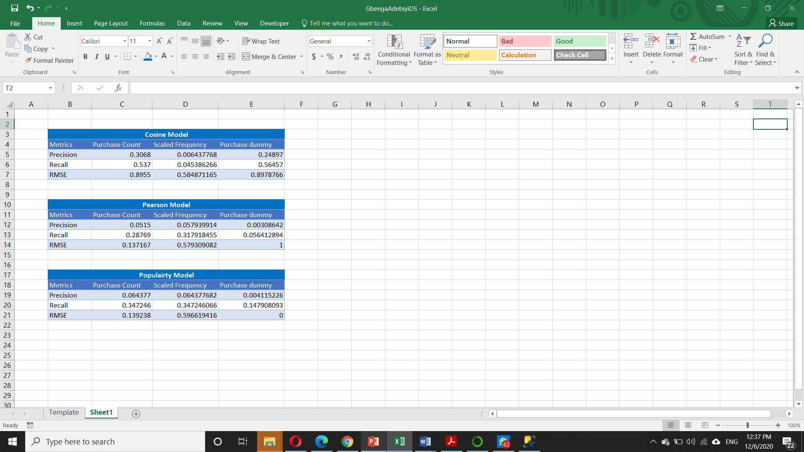
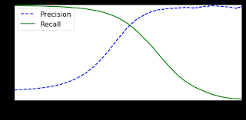
Precision and Recall Values

Slide 21
Evaluating Model Performance- Summary
Popularity vs. Collaborative Filtering: We can see that the collaborative filtering algorithms work better than popularity model for purchase counts. Indeed, popularity model doesn’t give any personalization, as it only gives the same list of recommended items to every user.
Below is the evaluation summary of the 6 Collaborative Filtering models
Precision : We see that the precision for ‘Cosine similarity on purchase counts' > ‘Cosine similarity on scaled purchase counts' > 'Pearson similarity on purchase counts' > 'Pearson similarity on scaled purchase counts'
Recall : We see that the recall for 'cosine similarity on purchase counts‘ & ‘purchase dummy’ is greater than others
RMSE: The RMSE for ‘Cosine similarity on purchase count' is slightly greater than ‘Pearson similarity on purchase counts‘. This negligible and with a better score (harmonic mean of our precision & recall) , the cosine model on the purchase count is preferred.

Slide 22


Selecting the Optimal Model Based on the evaluation, the Item Similarity Model using Cosine Similarity - on the Purchase Counts Data is our final model
Transforming and normalizing data
Training models
Evaluating model performance
Selecting the optimal model
Popularity Model on Purchase Counts
Cosine Similarity on Purchase Counts
Popularity Model on scaled Purchase Counts
Cosine Similarity on Scaled Purchase Counts
Pearson Similarity on Scaled Purchase Counts
Cosine Similarity on Purchase Dummy
Pearson Similarity on Purchase Counts
Popularity Model on Purchase Dummy
Pearson Similarity on Purchase Dummy

Slide 23

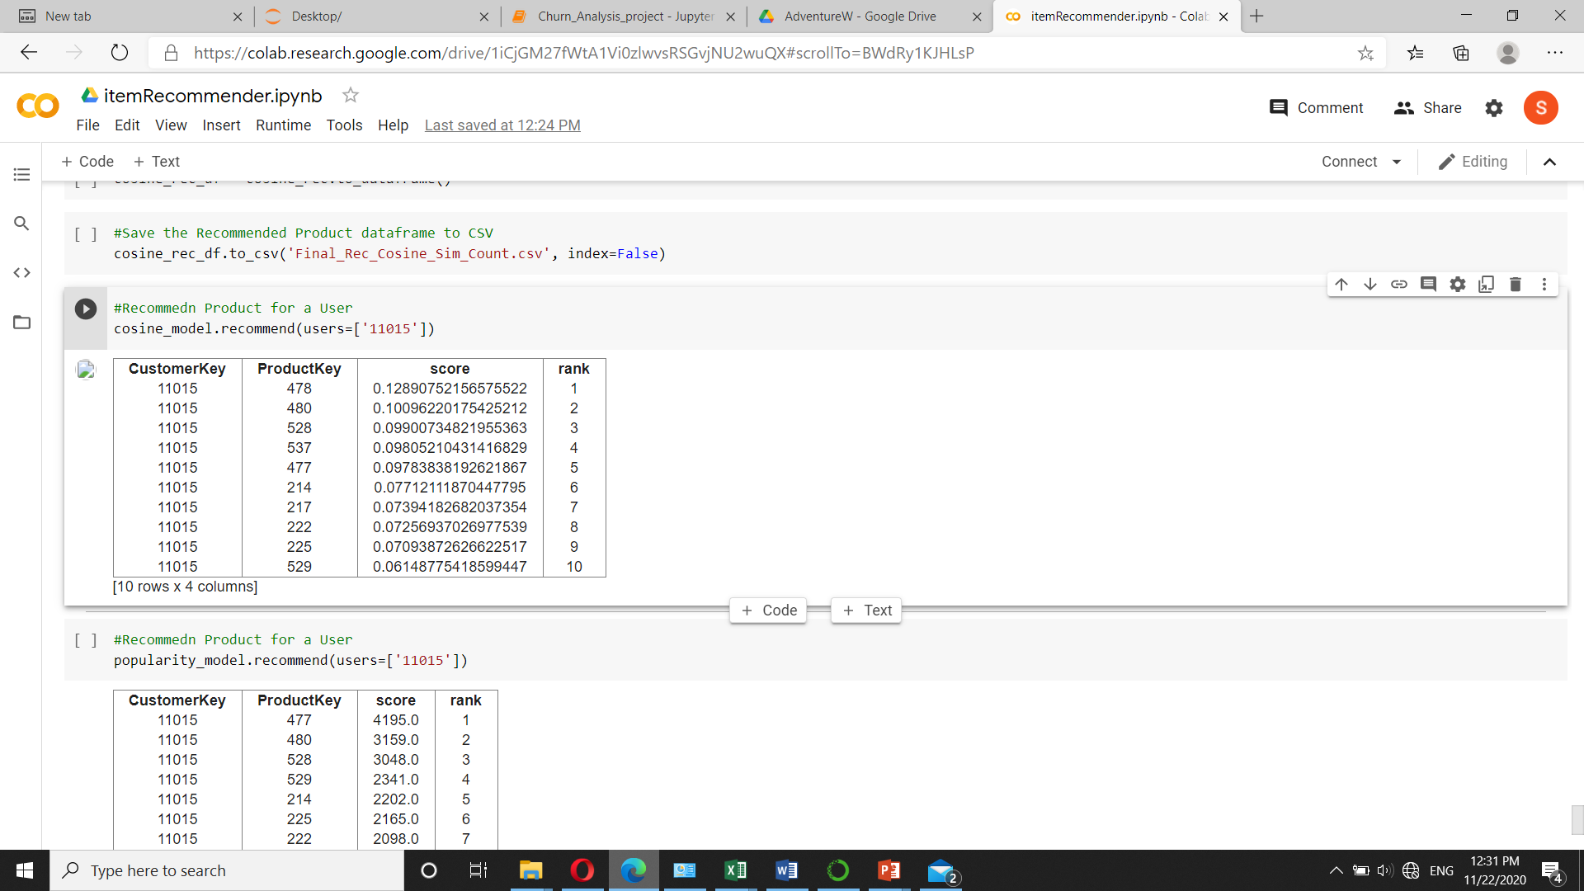
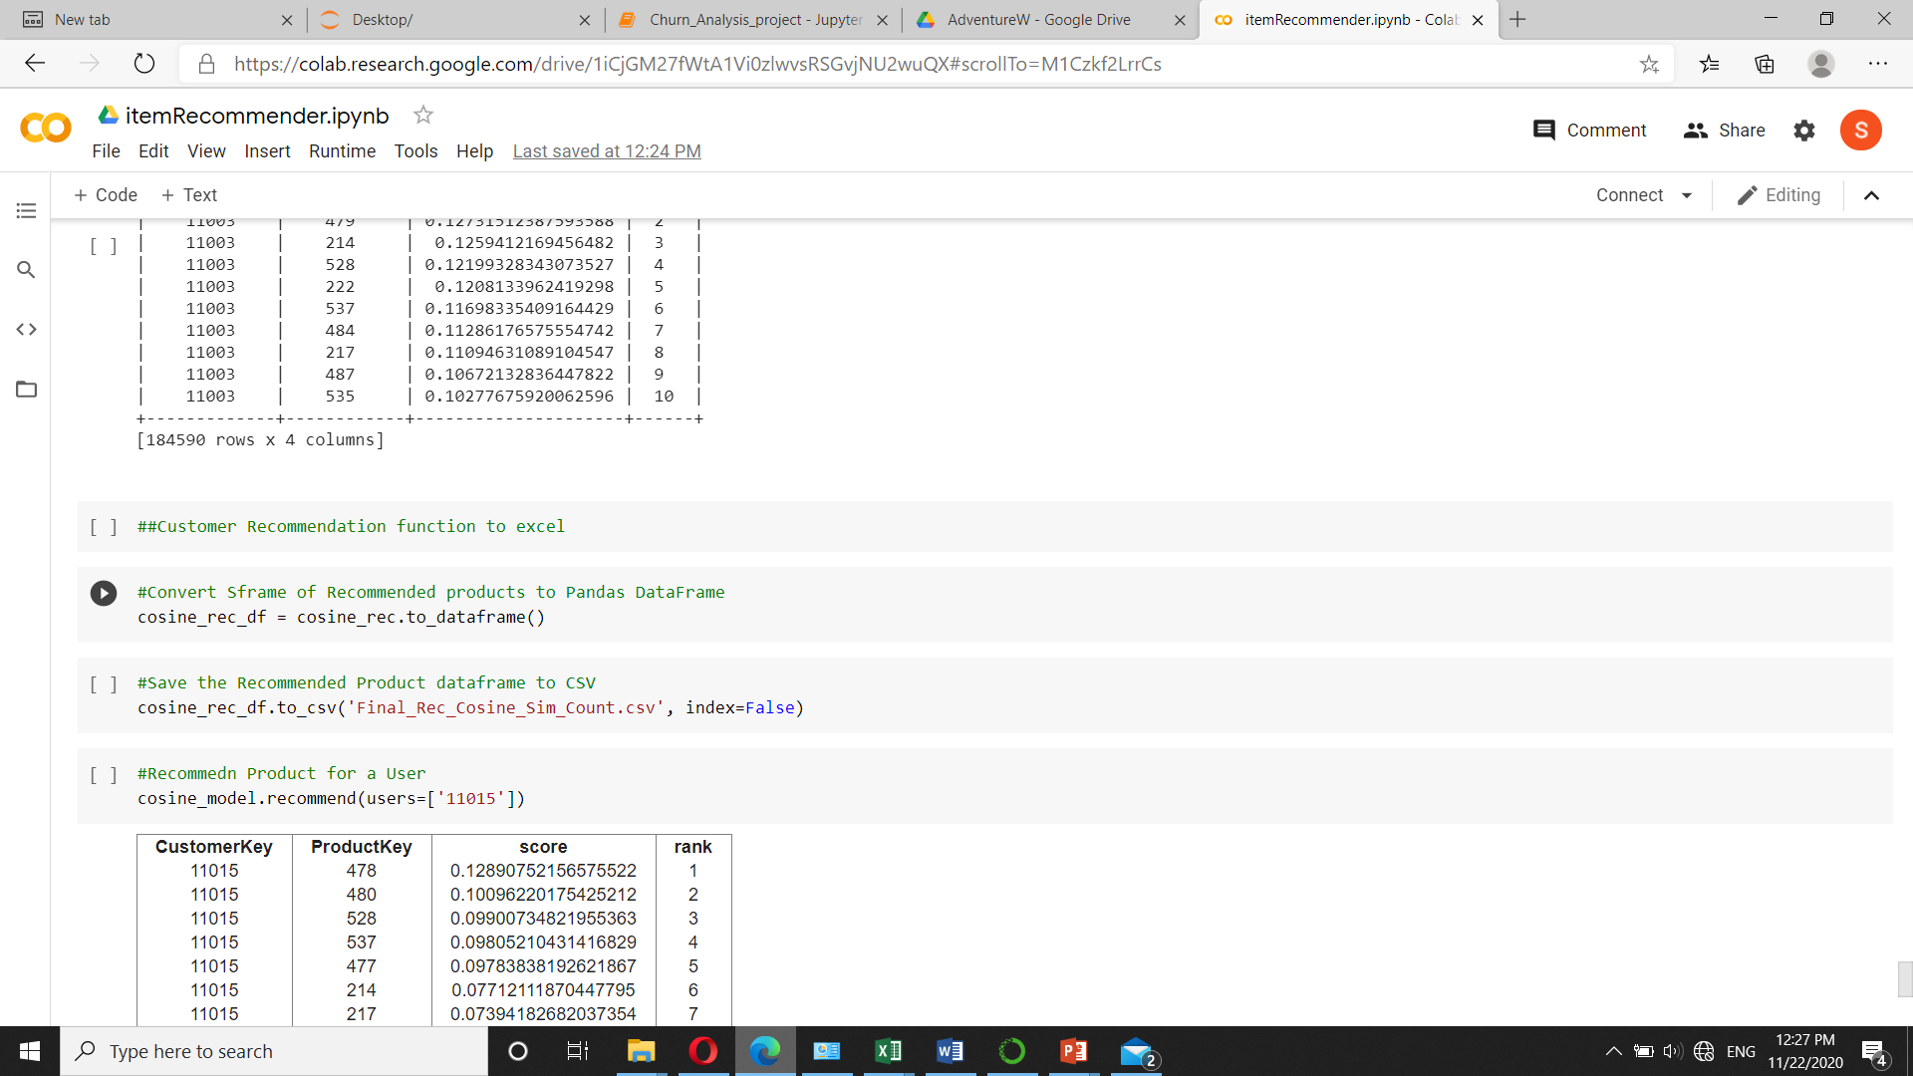

Model Output
A customer recommendations function in the code allows us to view the recommendations upon inputting the Customer ID, as below
The model recommendations are written into an excel file. A screenshot of this is below

Slide 24

Commercial Impact of the Recommendation Engine
To estimate the commercial impact of the recommendation engine, the last transaction data of the customers was used
The items recommended to the user from the recommendation model was then quantified in terms of volume, revenue and profit.
Using the Score of the model (precision and recall), we are able to estimate how many items of the recommended items the customer will actually purchase. This gave us revenue and volume.
The estimated additional revenue generated per year is £1 million
The estimated profit from using the recommendation model per year is $676,000

Slide 25
3. Predictive Model

Slide 26

Purpose of a Predictive Model
Of AHG’s 18,484 customer database - 5,559 customers have not made a purchase in the last 8 months. These are classified as customers who have churned, and impact the profitability of the business. The management needs quantifiable and timely metrics in order to tackle this.
The Predictive Model will find a pattern in the features of customers who have left in the past, and find similar patterns in existing customers, to send alerts if it finds that a customer is potentially going to leave.
This enables the management to take necessary retention measures

Slide 27
Methodology
Business Understanding
Data Preparation
Modelling and Analysis
Prediction and Analysis
Data Understanding
Understanding of business requirements
Definition of business parameters
Understanding of business goals
Understanding of the available data and data requirements
Data Exploration and Preliminary analysis
Conversion of variables to numeric
Selection of features
Training and Testing of Models
Evaluation & Selection of Best Model
Prediction, Analysis & Evaluation of Commercial Impact

Slide 28
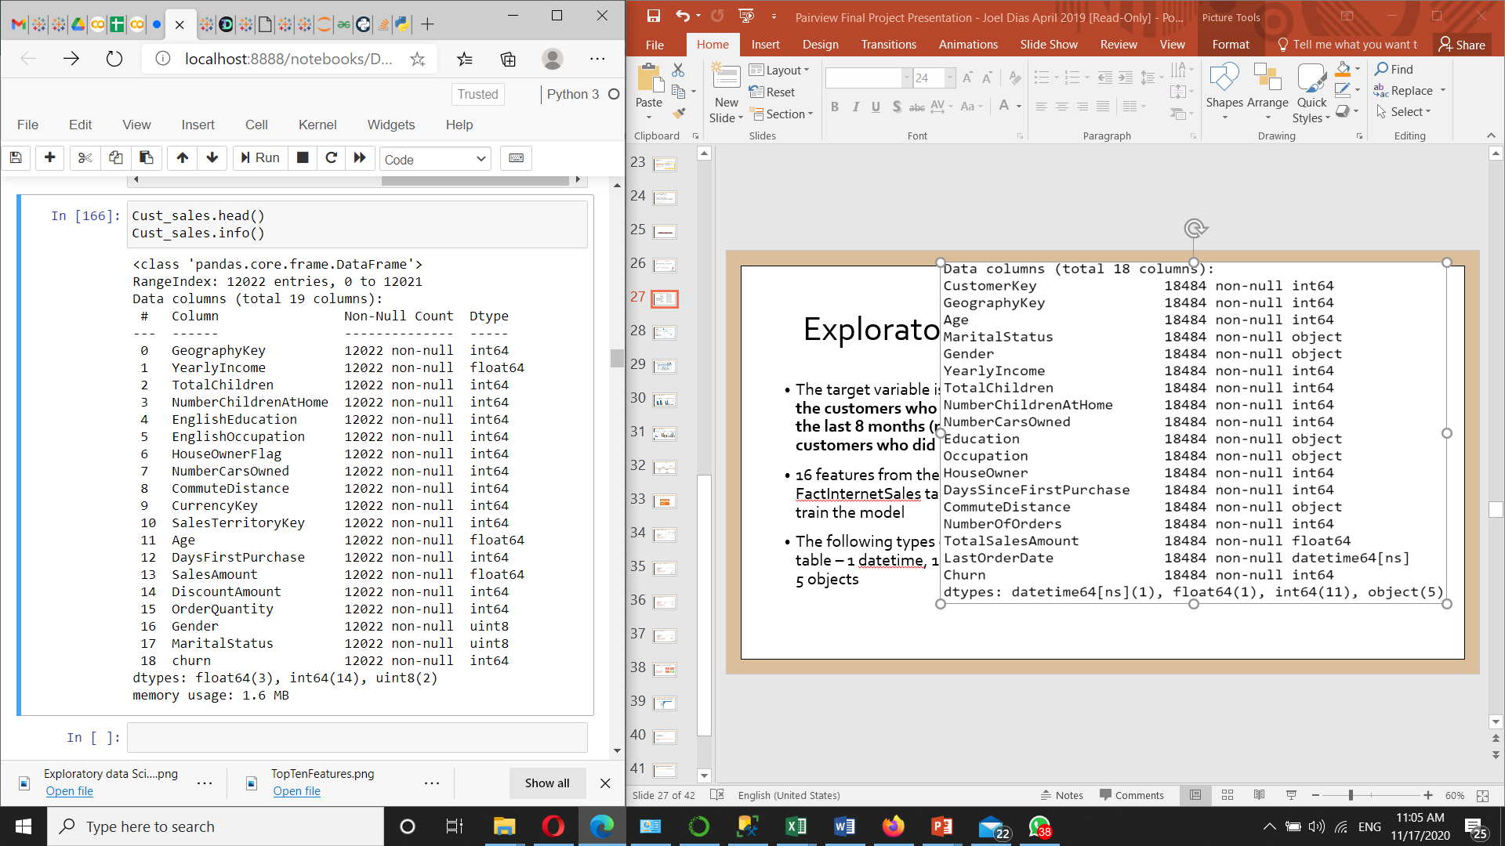
Exploratory Data Analysis
The target variable is churn, where zero is the customers who made purchases in the last 8 months (non-churner), and 1 is customers who did not (churner).
16 features from the DimCustomer and FactInternetSales tables are identified to train the model
The following types of data are in the table – 1 datetime, 1 float, 11 integers and 5 objects

Slide 29
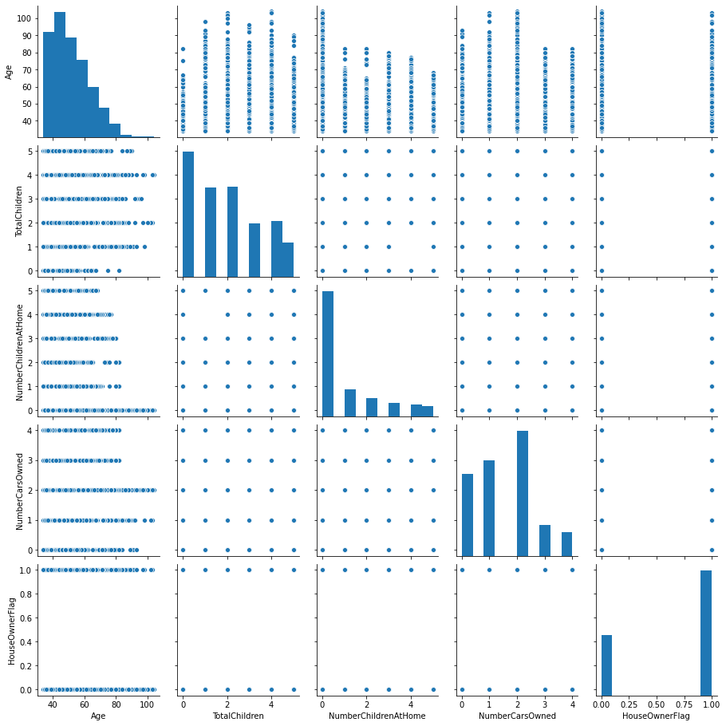
Exploratory Data Analysis
Upon plotting the distribution of continuous variables, we confirm that they are normally distributed, and that there are no outliers
Chi-Square test results confirm that the selected training variables are independent of each other

Slide 30

Exploratory Data Analysis Churner & non-churner average profile
Churners earns less and spends less as against Non-Churners
Churners also have more with average days since first purchase

Slide 31
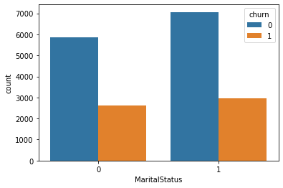
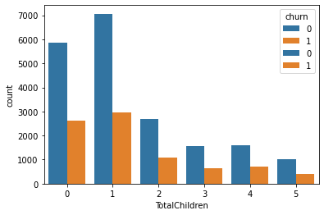
Exploratory Data Analysis
Upon plotting the input variables versus the target variable churn, we are able to visually identify certain key characteristics of customers
Married customers are more loyal (less likely to churn) than unmarried customers
A significant number of loyal customers do not have children

Slide 32
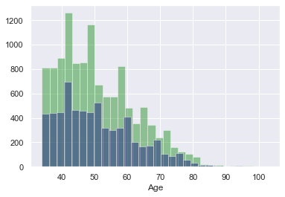
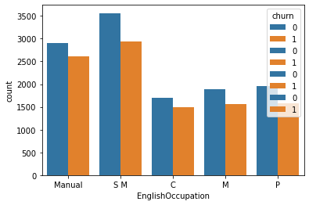
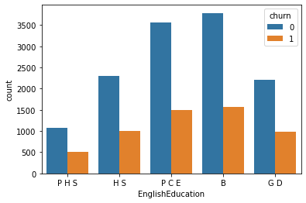
Exploratory Data Analysis
Graph
Most customers are in the age group of 35 to 49
More customers tend to be professionals or in a skilled manual occupation
Most customers tend to have a partial college education or Bachelors qualification

Slide 33
Data selection to train the model
18484 total customers.
Last order date 28-01-2014
Non Churners – 12,925
Made a purchase after 31-05-2013
Churners – 5,559
Did not make any purchase since 31-05-2013
Non-churners split into 2 parts
6,463 (to train model)
6,462 (to score model)
Model trained with
churners 5,559 + non-churners 6,463
= 12,022 customers
Training data was splitted into 10 folds used in training the data using Kfold

Slide 34
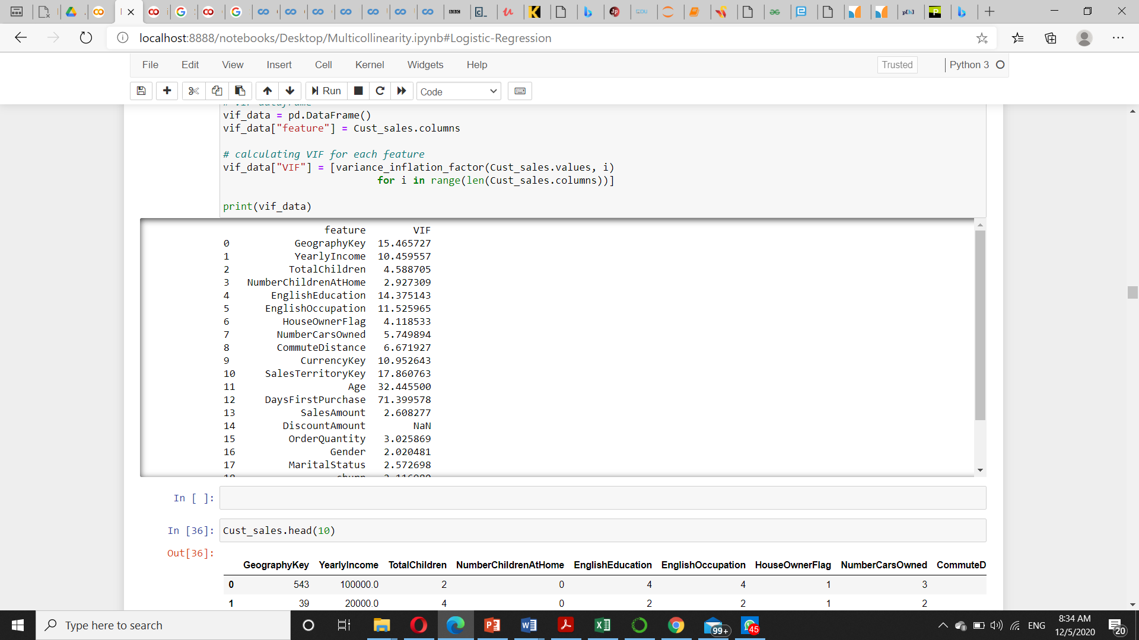
Multi-collinearity & Overfitting
The features with VIF (Variance Inflation Factors) > 10 correlate very highly with the other features.
However, removing these features impacts the accuracy and predicting power of our models. Hence, a trade off between model accuracy, AUC ROC Curve and interpretability of our models in terms of feature importance.
We chose to retain the variables for higher predicting power
To address overfitting, the test and train data was split into Ten (10) Stratified KFolds, and iterated over.

Slide 35
Predictive Models Trained
Decision Tree Classifier
Random Forest Classifier
Logistic Regression
K Nearest Neighbour
XGB Classifier
LGBM Classifier
The result for the two best performing models using ROC AUC score and accuracy are displayed in the following slides

Slide 36
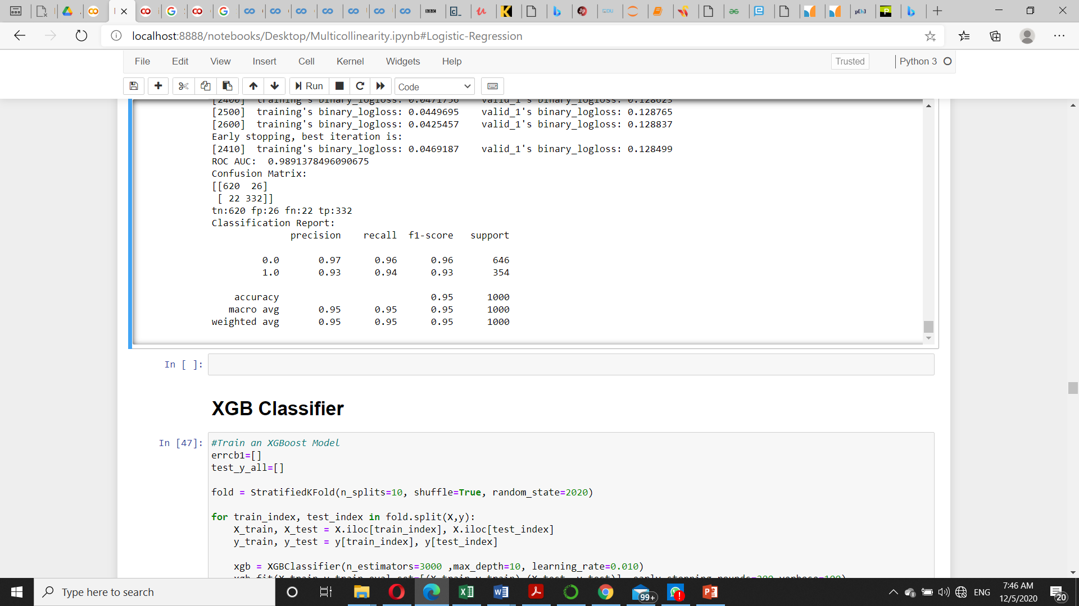
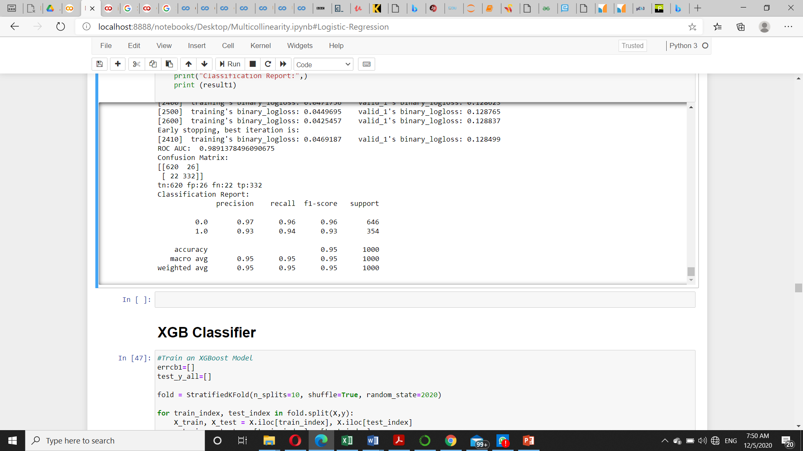
LGBM Classifier - Prediction & Evaluation
ROC AUC SCORE: 0.98913
Classification Report
The average precision is 0.95
The average recall is 0.95
The f1-score is 0.95
Confusion Matrix
Classified correctly as Non - Churners – 620
Classified correctly as Churners – 332
Classified incorrectly as Non - Churners – 26
Classified incorrectly as Churners – 22

Slide 37
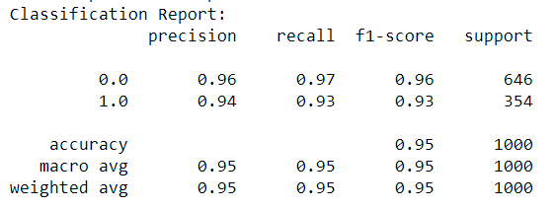

XGB Classifier - Prediction & Evaluation
ROC AUC SCORE: 0.98913
Classification Report
The average precision is 0.95
The average recall is 0.95
The f1-score is 0.95
Confusion Matrix
Classified correctly as Non - Churners – 625
Classified correctly as Churners – 328
Classified incorrectly as Non - Churners – 21
Classified incorrectly as Churners - 15

Slide 38
Model Selected – Random Forest Classifier
As per the classification report, of the 6 models trained, the XGB and Light GBM classifiers had similar outcomes, which is better than the others.
Taking the AUC ROC score into account, where the XGB Classifier had a marginally higher score, we will be using this model to train our final prediction model.
Decision Tree Classifier
Random Forest Classifier
Logistic Regression
K Nearest Neighbour
LGBM Classifier
XGB Classifier

Slide 39
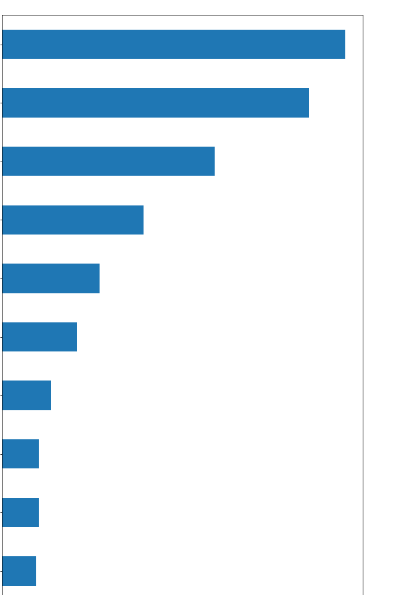
Top 10 Important Features of the Model
Total Sales Amount
Days Since First Purchase
Geography Key
Age
Yearly Income
Order Quantity
Commute Distance
English Education
Total Children
English Occupation

Slide 40
Commercial Impact of Churn
Customers scored – 6,462
Customers likely to churn – 314
Customers likely to stay – 6,148
Average revenue per customer per year- $1,588
Total revenue loss from customers likely to churn per year is $498,000

Slide 41
Recommendations to Prevent Customer Churn
Identify customers that are likely to churn on a weekly basis. Any customer that has not purchased items over the last 5 months is to be classified as a churner or non-churner
Upon identifying a potential churner, email/post a promotional voucher or discount coupon
Identify recommended product from the recommendation model and send related promotions to the buyer
Ask for feedback and recommendations on product range + specification from customer to engage and revive them

Slide 42
Thank You

